Slide 1


Long Term Plan 2023 – 2028 User Guide
July 2022

Slide 2
Summary
1. Connection to Tango
Connection to Citrix Client
Settings of Citrix Client
Settings of Tango
Go to the Long Term Plan in Tango
Tango Documentation
2. How to fill in the Long Term Plan
Simplified LTP models
Dimensions in Tango
Context Selection
Plan Input
P&L
FCF
BS
IFRIC12
IFRS16 simulation
3. How to retrieve the Long Term Plan
The Management Reports
Plan Output
Masterfile Output

Slide 3

1. Connection to Tango

Slide 4
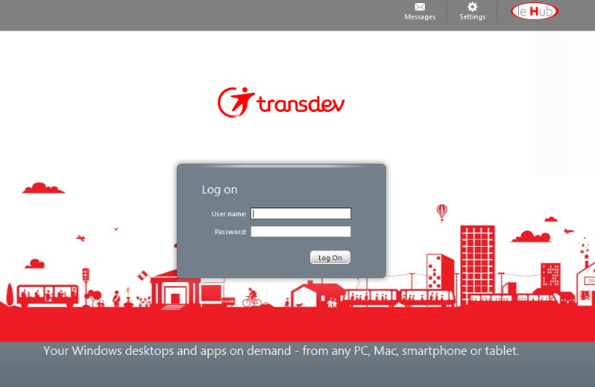
Connection to Citrix Client
Connect to this web page :
https:// citrix.transdev.net/
Enter your Windows ID’s
User Name
Password

Slide 5
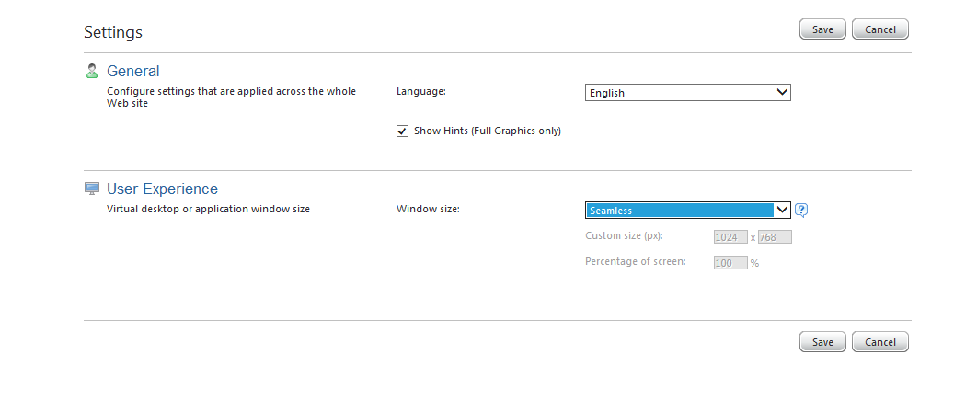
Settings of Citrix Client
1
2
3
We recommend you to use the option « seamless » window in settings

Slide 6
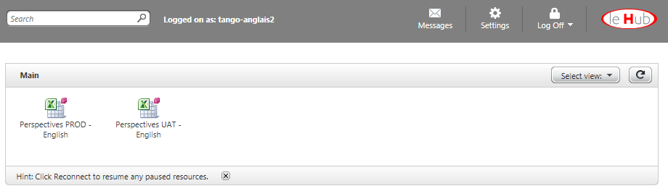
Settings of Tango
Click on the icon “Perspectives PROD – English” or “Perspectives PROD – Français” to open Citrix

Slide 7
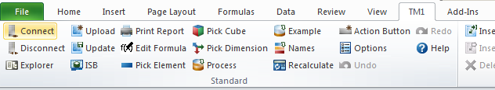

Settings of Tango
1
Select TM1 in the tool bar
2
Click on the icon « Explorer » to open TM
Double Click on the instance « Tango_Core_Model »
3
No login neither password are required

Slide 8
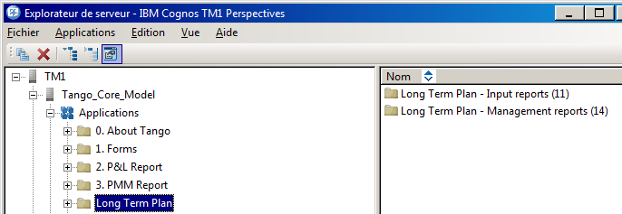
Go to the Long Term Plan into Tango

Slide 9
Tango Documentation
All Tango documentation is available:
On Expert.net
Finance community / Financial Control / TANGO Core Model ​- Financial system​​ / TANGO- Forms & User Guides
Or Using the link below
https://lehub.sharepoint.com/sites/Expert.NET/Communities/Finance_community/Tango/Forms/AllItems.aspx?web=1&id=%2Fsites%2FExpert%2ENET%2FCommunities%2FFinance_community%2FTango%2F1%2E%20Connection

Slide 10

2. How to fill in the Long Term Plan

Slide 11
Simplified LTP models: main changes on templates and accounts
 | LTP 2019 | LTP 2021 | Comments
Templates | 6 input templates: Capex, IFRIC12, 3 sheets for IFRS16, plan input | 1 input template IFRIC 12 table added at the bottom of the input template IFRS16: cost of financing, Right of Use and Lease Liability are not isolated anymore | IFRIC12 are automatically computed from IFRIC12 table into the plan input Possibility to simulate IFRS16 impacts on your LTP using a dedicated template
 | 5 dimensions to be filled in at country level | For countries, dimensions to be filled in limited to: ZGP & Action Plan Organic Growth External Growth will be managed on top | Both templates are structured identically
P&L | Split of COS/SG&A by nature | Cash & non cash elements are filled in directly in the P&L No detail by nature : no detail on COS neither on SGA | Breakdown of COS/SG&A per activity was not really reliable
 | Cost of Net Financial debt: Net Financial Interest – Without IFRS16 Interest expense on IFRS16 Lease Liability | Automatic calculation of: Cost of net financial = average debt * country interest rate Income tax = Profit or loss Bef Tax * country theorical rate (if profit or loss bef tax > 0) | Possibility to report the proposal if accurate or to fill in your own calculation
FCF | CAPEX: CAPEX – Rolling Stock CAPEX – Other CAPEX – Right of use IFRS16 | CAPEX: No split between financing modes (excl. IFRIC12) IFRIC 12 remains isolated in a dedicated table | IFRS 16: No more details on IFRS16 indicators which were mainly used during the transition year in 2019 IFRIC 12 are automatically reported in plan input
 |  | Automatic calculation of: Financial interest = average debt * country interest rate Dividends = 100% of net result Y-1 (if Net result Y-1 >0) | Possibility to report the proposal if accurate or to fill in your own calculation

Slide 12
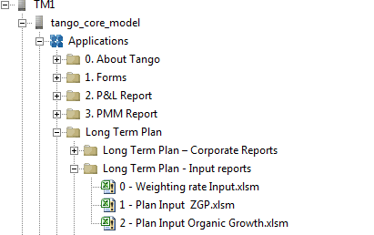
The Dimensions in Tango
Country level:
Zero Growth Plan & Action plan
Organic Growth Plan
Managed on top:
External Growth Plan
Select the Long Term Plan element in Tango Core Model
Weighting rate input has been designed to apply a percentage to a plan originally designed at 100%
This functionality has been built for group top arbitration.
It may be used by countries upon request to your financial controller

Slide 13
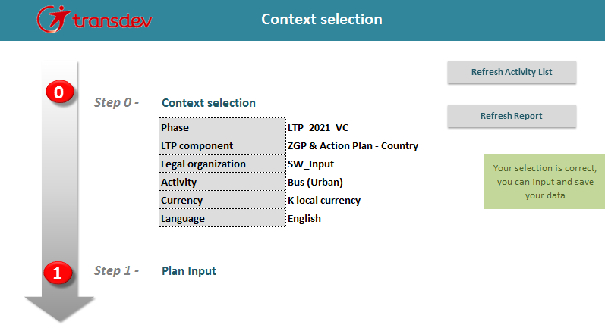
Context Selection (1/3)
Select your Legal organization Double Click
(detailed in the next slide)
1

Slide 14
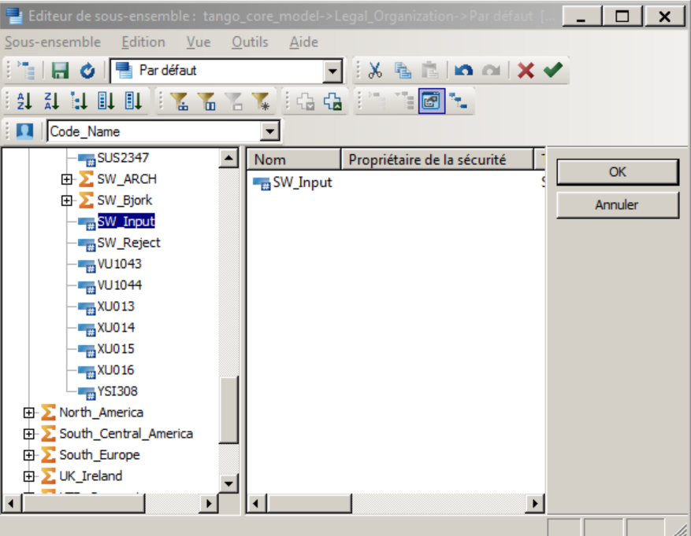
Context Selection (2/3)
Click here if you want
to switch from the
code to the entity name
Select the right
entity in the list
2
As defined with you, you should select either:
Your country input entity (ex: On demand – Input technical entity)
One of your ‘Vector’ entities
Click on OK when selected
3

Slide 15

Context Selection (3/3)
When your legal organization is selected, refresh your Activity list
4
Select the right activity
(Long Term Plan activities validated with Corporate team)
5
6
Refresh the report

Slide 16
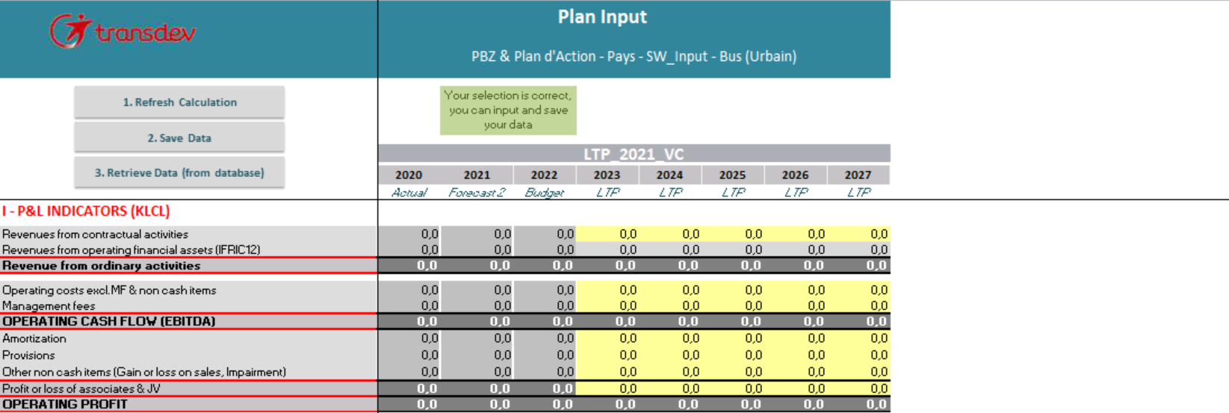
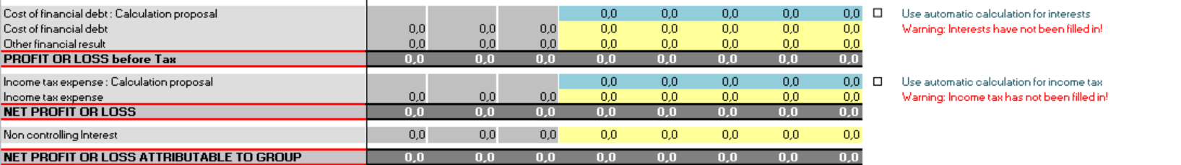
Plan Input – P&L (1/4)
Fill in the P&L indicators Fill in all the yellow cells in the template
1
You can use the automatic calculation for:
Cost of financial debt
Income tax expense
Tick the box to use the proposed calculation or fill in your proper calculation in the yellow cells
2
Save Data
Save Data as frequently as possible in order not to loose information
3

Slide 17
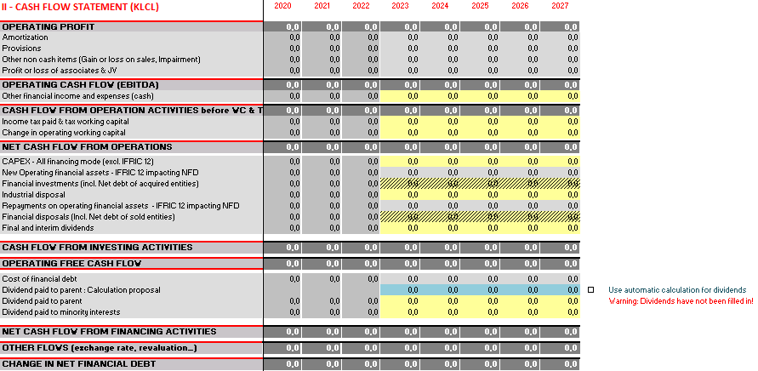
Plan Input - FCF (2/4)
Fill in the Cash Flow Statement indicators
Fill in all the yellow cells in the template
1
You can use the automatic calculation for dividends input
Tick the box to use the proposed calculation or fill in your proper calculation in the yellow cells
Financial investments and disposals will be managed on top and can not be filled in at country level (shaded cells)
2
Save Data
Save Data as frequently as possible in order not to loose information
3

Slide 18
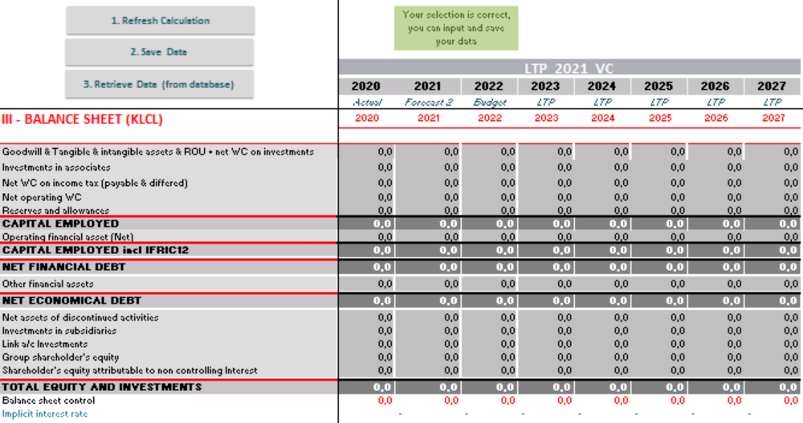
Plan Input - BS (3/4)
Balance sheet is automatically computed with all data entered
Please check consistency of implicit interest rate generated by the automatic calculation of cost of financial debt

Slide 19
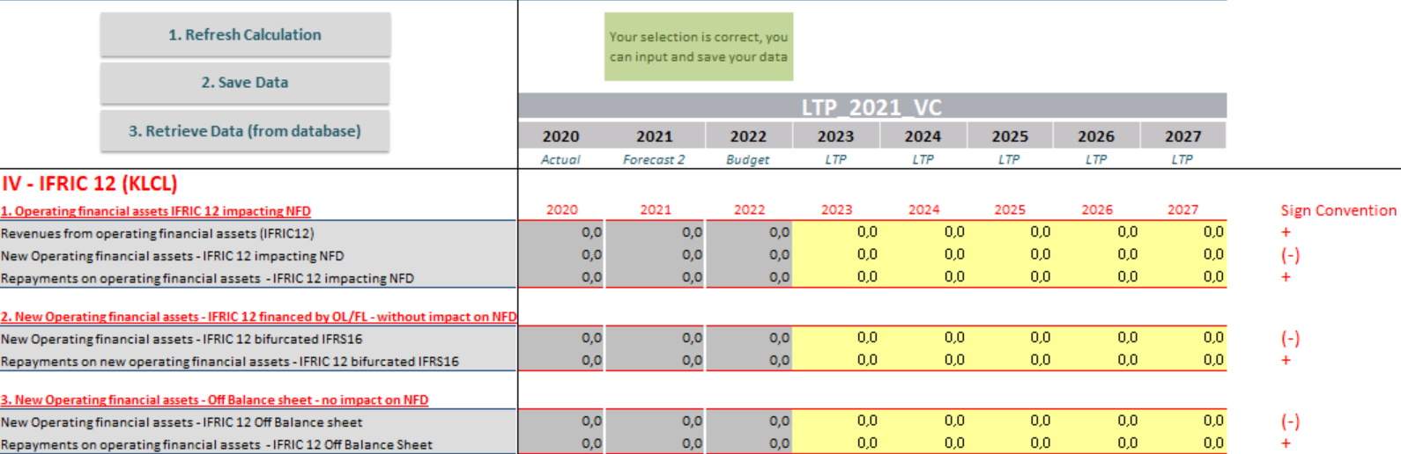
Plan Input – IFRIC 12 (4/4)
Whatever the consolidation method, all IFRIC 12 investments should be isolated in order to assess the total financing needs for the group.
The dedicated template at the bottom of the plan input should be used
2
Save Data
1
Enter the amounts of Operating Financial assets
1st Tab : Assets impacting NFD (will be automatically reported in the plan input)
2nd & 3rd Tab : Assets without impact on NFD → no impact in the plan input but data saved in the system
for specific analysis

Slide 20
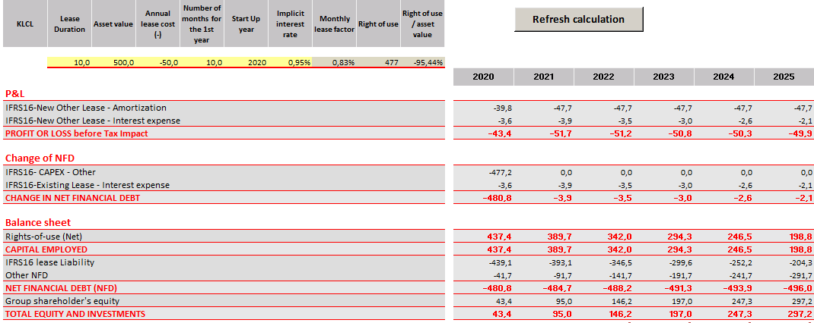
IFRS 16 Simulation
You can simulate IFRS16 impacts on your LTP using this template.
This is only for information, this sheet is not connected to tango and information filled in is not saved
1
Fill in the details of the lease
Refresh calculation
or press F9
2

Slide 21

3. How to retrieve the Long Term Plan

Slide 22
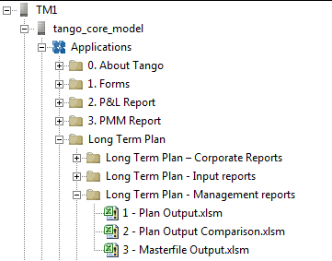
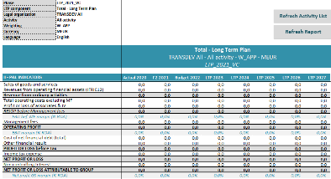
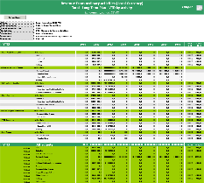
The Management Reports
Select the Long Term Plan Element in Tango Core Model
Detail of the 2 main management reports
Plan Output:
Same format as the plan input filled in
Consolidated view of the country Long Term Plan and Corporate adjustments
Masterfile Output:
Breakdown per activity on one dedicated indicator

Slide 23

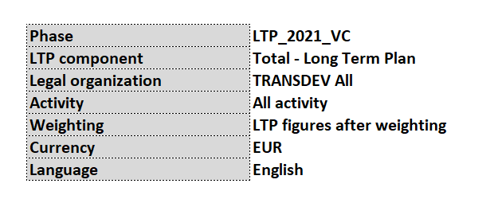
1. Plan Output (1/2)
Select your phase Long Term Plan 2021 VC
1
Select your LTP Component
(detailed in the next slide)
2
Select your legal organization (same method as input report)
3
4
Refresh Activity List
5
Select the activity
6
Select the currency (LCL, KLCL, MLCL, EUR, KEUR, MEUR)
7
Refresh the report

Slide 24
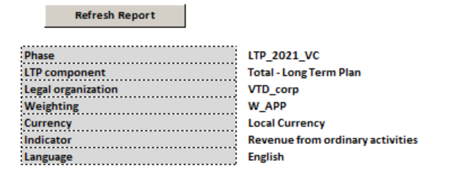
2. Masterfile Output (1/2)
Select your phase (same method as Plan Output)
1
Select your LTP Component
(as detailed in the previous slide)
2
3
Select your legal organization (same method as input report)
4
Select the currency (LCL, KLCL, MLCL, EUR, KEUR, MEUR)
5
Select the indicator to retrieve Double click (detailed in the next slide)
6
Refresh the report

Slide 25
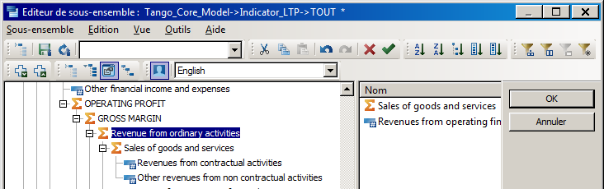
2. Masterfile Output (2/2)
Click here if you want to expand all the dimension
Click here if you want to switch from the code to the indicator wording
1
Select your indicator (for example Revenue from
ordinary activities)
2
Click on OK

